Slide 1
Campus 2022
Prepartions
Prof Manoj S Khaladkar
Jaicy S Chacko
Army Institute of Technology

Slide 2

Golden Triangle … K A S for BE . Knowledge , Application and Skill

Slide 3
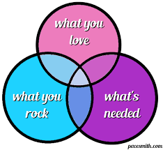
Hit the Centre …

Slide 4
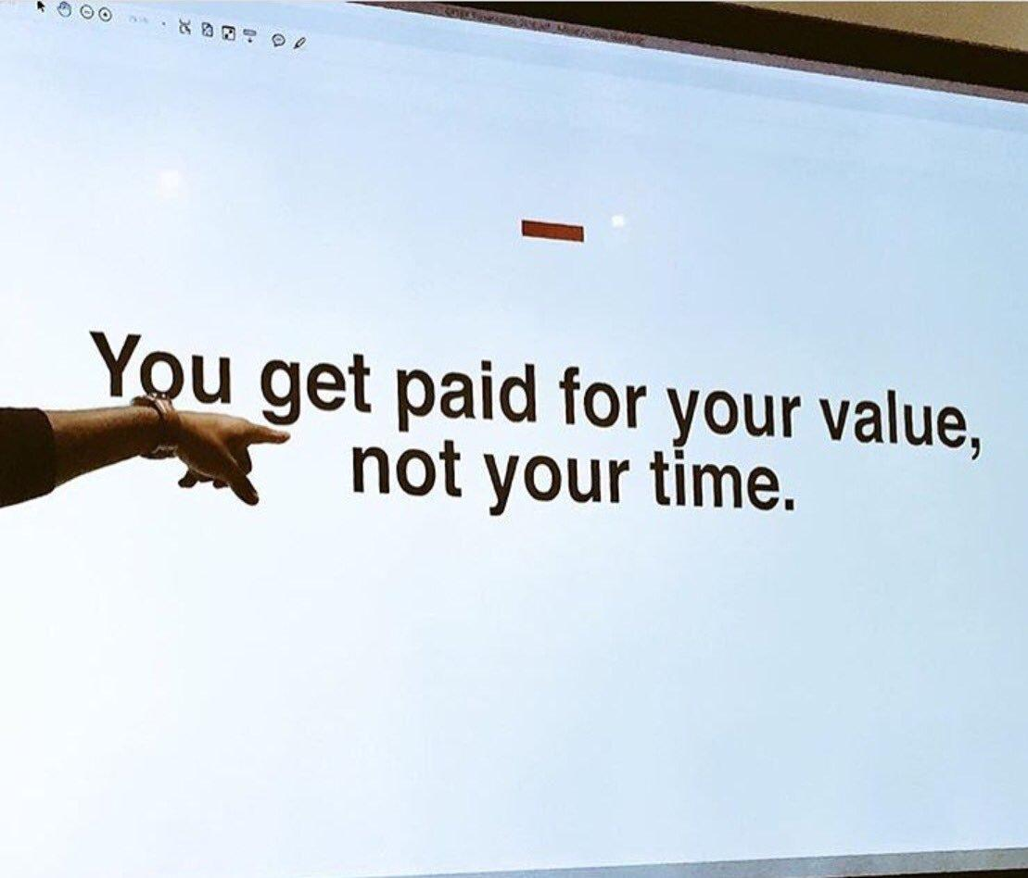

Slide 5
Basics …
Define the Career Well .
Study all industries …website , Glass door views .
Do not run behind CTC .
Job profile , your interest , future and culture are more imp .
Do not compare with other branches .
Uniform with proper attire on interview days , even if it’s Virtual

Slide 6
Imp Rules
1. Condition of Attendance is strict .
2. TCS Ninja is NOT under One Job Policy .
3. AMCAT - test scores will be shared with other industries . It Is Must .
4. Mock PI is mandatory .
6. Two copies of CVs + mark sheets with folder..

Slide 7
Employment Generation in India
S.No | Sector | Percent
1. | Financial, Real Estate & Professional Services | 20.9%
2. | Trade, Hotels, Transport, Communication, and Services related to Broadcasting | 18.2%
3. | Agriculture, Forestry & Fishing | 17.0%
4. | Manufacturing | 16.1%
5. | Public Administration Defence and Other Related Services | 15.0%
6. | Construction | 7.9%
7. | Electricity, Gas, Water Supply and Other Utility Services | 2.5%
8. | Mining & Quarrying | 2.4%

Slide 8
Opportunities of Employment
Engineering Student
Core Manufacturing
Professional and Business Services
R&D Labs
Sales & Marketing
Supply Chain Professionals
IT Product Development and Maintenance
IT enabled Systems and Services

Slide 9
Two Facts
Scenario of Fresher's Hiring in India
Advertisements - 20%
Online Portals – 30%
Referrals - 20%
Campus Recruitments - 30%
Choices after BE
Job
Value Add Courses
Higher Education
Non conventional careers
Entrepreneurship
Govt , Defense etc

Slide 10
How is the …..JOSH …!!
Career in Defense Forces after Engineering …
UES …. Only for Navy .
CDS …. Most popular entry for all 3 forces .Twice in a year at final year appearing and after passing out .
For Girls … SSC ( W ) Tech . For 10 + 4 yrs .
Air force … AFCAT . Twice in a year .Short service for all 3 roles , Flying , Technical , Ground duties .
TGC … Technical Graduate Course . After Graduation up to age of 27 . Only interview .
SSC ( Tech ) - Final year appearing . If Merit fails for TGC , automatic consideration for SSC Tech .

Slide 11
Part 2
Preparing for Campus ……

Slide 12
Rounds of Campus Recruitment
Aptitude Test - Written / On Line ( AMCAT ,CoCubes , E litmus , Hire pro ,first Naukri, Mettl ). – Intelligence + Technique + Time Management .
Technical Test – Testing Knowledge +Application .
Group Discussion .
Technical Interview ….Refer an evaluation sheet .
HR Interview ….Refer an evaluation sheet .
Special prep - For Deloitte and ZS .

Slide 13
How to prepare for campus
Make small groups .
Take 5 tech questions and 5 behavioral questions and brainstorm .
Make a note book and write down your answers .
Concentrate on mini projects .
Keep communication clear .
Feel free to interact for training needs .

Slide 14
Mandatory fields in CV….
Name , Branch , Institute .
Career Objective .
Academic Details .
Technical Skills / Proficiencies / Branch skills .
Scholastics Achievements ( Scholarships – College/ school , Ranks , Awards , Merit , etc ).
Co curricular Activities/Achievements,Technical papers , patents , research , Conferences , Workshops )
Brief about Summer / Winter Internships ( if Any ) .
Extra Curricular Achievements / Activities ( sports , Debate , Music )
Personal Strengths , Hobbies and personal Details .
Competitive Coding , BAHA , SUPRA is Must .

Slide 15
Evaluation Formats
HR Int
https://drive.google.com/open?id=1KM8p9hZskwTyWe39PKK7zW9_pm4DrxiJ
Tech IT/ ITeS
https://drive.google.com/open?id=19XwocxEATUyS74445kfEmkXUrhbXxJGO
Tech Int
https://drive.google.com/open?id=1Tto479gUbXMMVVf_Dc2tyRPFs5ujIeXF

Slide 16
Sky is the Limit ….
Here are a few links to practice for coding, data structures, algorithms and aptitude
www.hackerrank.com
www.geeksforgeeks.org
www.hackerearth.com
www.codeforces.com
www.codechef.com
www.indiabix.com
www.spoj.com
www.a2oj.com

Slide 17
For Interviews ….
Here are a few links for interview type questions
www.topcoder.com
www.coderbyte.com
www.projecteuler.net
www.crunchbase.com/organization/codeeval
www.codewars.com
www.leetcode.com
www.codingame.com

Slide 18
Data Science , Python and R
Here are a few links for data science using python, and/or R
https://r4ds.had.co.nz/
https://scikit-learn.org/stable/

Slide 19
Learn the Industry
Website and Domain .
Pattern of fresher hiring .
Products , Services .
Skill sets expected .
Habit of reading Times Business watching Business news .
Study of profiles and roles generally offered .
Full Stack Developer .
DevOps .
Why Core and Engineering Industries pay Less …?

Slide 20
Learn Management to know the Industry and world .
Sectors .
Organizational Behavior .
Organizational Model and structure .
Simple Finance terms .
Scale of Business .
Business Communication .

Slide 21
Make Your WHY strong ,HOW will automatically follow .
No Job Profile is Secondary .
Always Ask , What Can I do for Your Organization .
For e.g. Software testing or QA - I am the Most Responsible Person for Signing Out .
BE is Beginning of Engineering .
Learn ..Learn and Learn for one year .
Learn More , Learn Fast .

Slide 22
Think and Learn …
Facebook , LinkedIn , Paytm , Zomato , Swiggy .. How they operate .
Infosys , TCS , Cognizant , Wipro , Accenture …?
What is VC Funding , Angel Funding .
What is Capital , Revenue .
Be mature in the interview process .

Slide 23
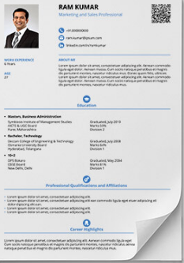

How to Write your Resume
Resume is not just a document It’s your first meeting with your prospective employer
Do’s
Keep your Resume SHORT
Enlist technical skills required for the job
Read your resume quite often you will find ways to improve it
Write different resume for different opening
Think before you write
Don’t
Cut, Copy Paste
Write in team, its all about yourself
Write anything that you can’t explain
Strength | Weakness
Opportunity | Threat
Note: Use SWOT analysis as tool to write your resume
Copyright © 2018 Lakshya Professionals - All Rights Reserved
Notes:
I am asking to keep this short but why . To answer that
Q→ Do you know how much time your interviewer gets to read through your resume ( 1 to 3 minutes max) ( Share personal experience with the HR as part of the panel)
( It takes few hours to write a four pager resume however it takes hours to write a short and sweet resume , So give it its due respect)
For 2 – Understand the job position, list relevant projects that shows your implementation skill as per the requirement, Ask for JD before appearing for any interview
Reading – Helps to understand your resume better, helps to answer questions with confidence, you will find various ways to improve it.
Every position is different and one size does not fit all, write new resume for each opening you may reuse it if you find two positions very similar.
When you think it gives you time to think about yourself, you understand yourself better, you may realize there any many things that you may never have thought of . I you wish talk to few of your close friends who understand you. And then put together in your own words.
No teamwork here please. Its about yourself. Put only those things that you are comfortable answering. Don’t invite undue questions.

Slide 24
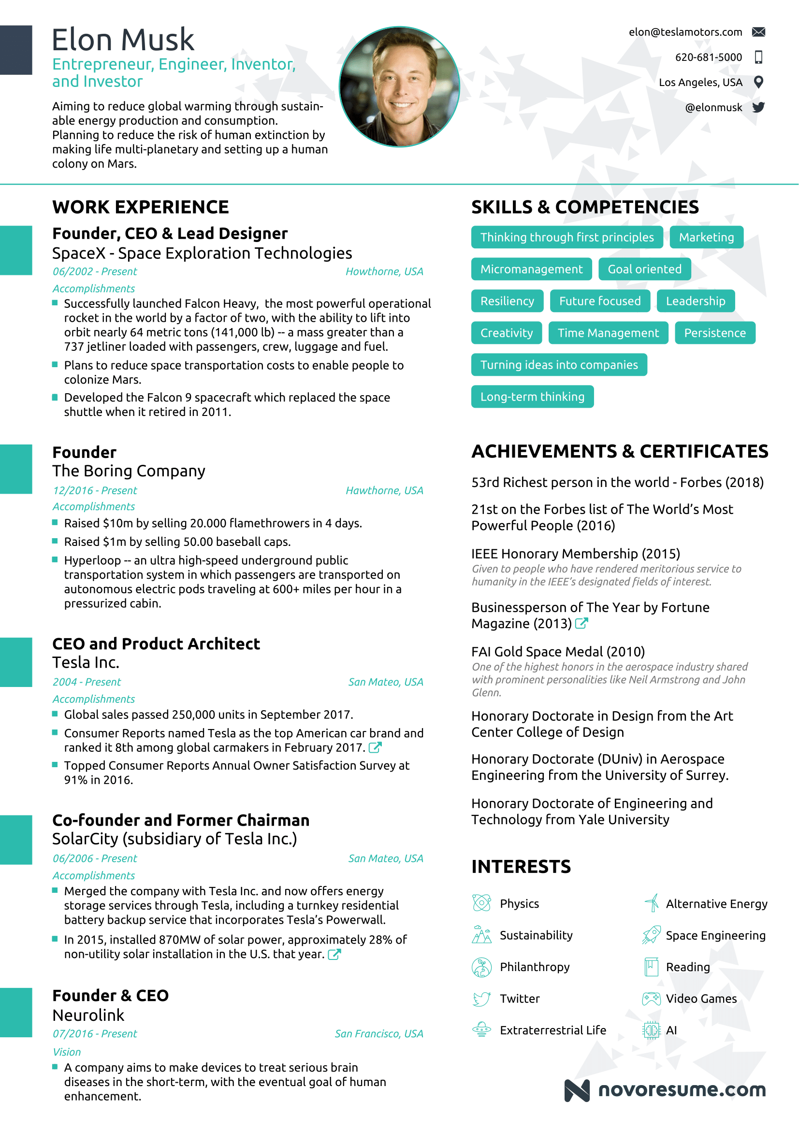
Notes:
Q→ Why do you think resume is so important – Because it is the first meeting with the prospective employer.
Q→How much time HR gets to scan through the resume? ( At average 20 to 30 sec) max a minute

Slide 25
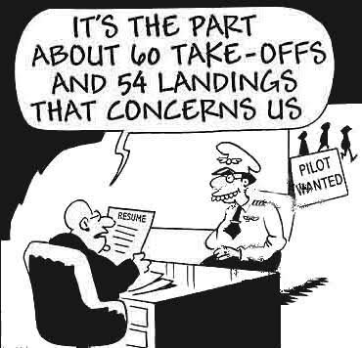
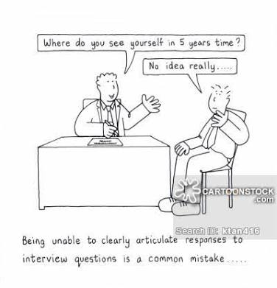
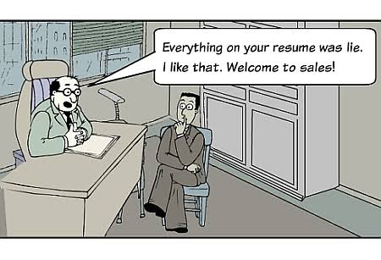
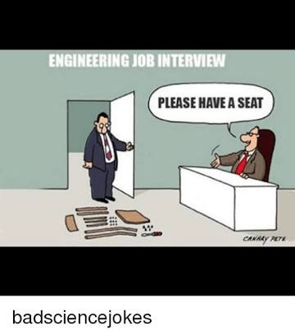
What does an Interviewer look for?
→ Technical Competence
→ Ability to Communicate and Articulate
→ Practical Application Of Knowledge
→ Integrity
Notes:
Technical Competence – How deep a knowledge do interviewers want? (on request from TPO)
Projects and Seminars
No code syntax
Wider rather than deeper
Know what you know well
Understanding of principles
Ability to explain
Eg : AM & FM, AC litres
Wrong answers do not mean you won’t make the cut. Move on.
Technology Trends
However, ultimately depends on company – OS porting for example (Calsoft)
Sneak-Peak from the Interviewers lens

Slide 26






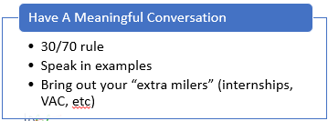
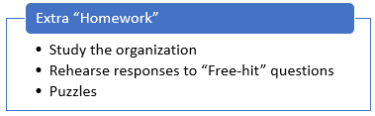
Getting the most out of your interview
Copyright © 2018 Lakshya Professionals - All Rights Reserved
Notes:
The first 3 minutes
Like a GMAT/GATE scoring pattern
Most influential time you will invest
Make a +ve impression
Make the interviewer want to hire you
Presentation
Very well dressed
Walk-in with confidence
Be organized
First interaction/questions
Set the tone of the interview
Avoid the “take time to settle in” trap
Each question is an opportunity
Interviewers know next to nothing abt what you do
Draw most questions from information that you give them
(1-2-3 rule for digging deeper, based on one question)
YOU CAN DRIVE!
30:70 rule
Express yourself, elaborate ideas
Speak in examples
Avoid one-word answers
Speak as equals
It’s a win-win game
Try not to look for a right answer – most questions don’t have a right or wrong answer. All answers are right
A little humour always helps
“Stress” questions
To test your responses under stress
You can disagree, as long as you are polite about it
Answer questions one-by-one
Avoid saying “your company”
Mention the org by name
You are hoping it will be “our company” soon :)
Read-up on the organization
Company profile
Important products
Major clients
Size and spread
Any recent news
“Free Hit” Questions
“Tell us about yourself?”
“Why Computer Engg?”
“Why xyz specialization?”
“Why do you want to join xyz organization”?
Be prepared to answer these questions
Read-up on puzzles

Slide 27
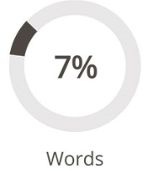
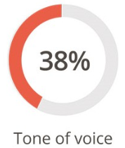
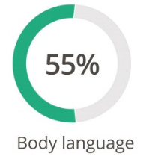

Body Language - Are you projecting the right message?
A
B
Notes:
93% comms is non-vbl (55% Body Language, 38% Tonal); only 7% is words
Positive Markers for body language
Communication
10 feet rule
“Can you rephrase / repeat?”
Think fast, talk slow

Slide 28








Body Language - Are you projecting the right message?


Notes:
93% comms is non-vbl (55% Body Language, 38% Tonal); only 7% is words
Positive Markers for body language
Communication
10 feet rule
“Can you rephrase / repeat?”
Think fast, talk slow

Slide 29
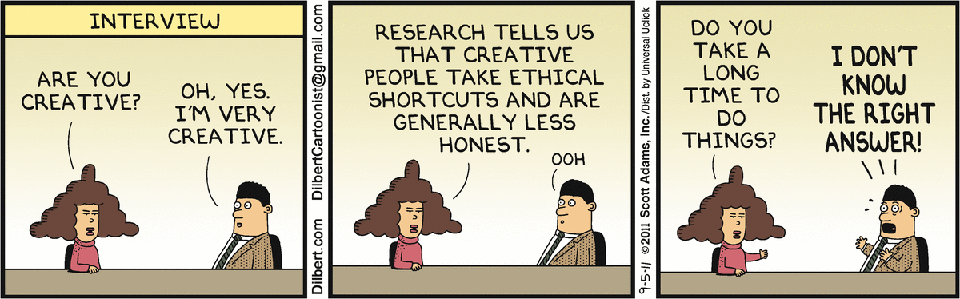
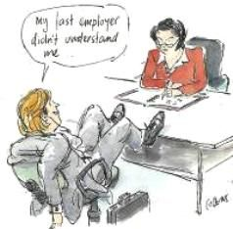
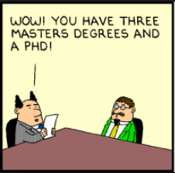
Common “Mind Traps”
→ “Agree-culture” mind-trap
→ Casual attitude
→ Bluffing through the interview
→ Wasting the “Do you have any questions” opportunity
So, what does your company do?
What is the vacation policy?


Ma’am, how did I do in the interview?



Slide 30
For Etc and Mech students …
1. Percentage of core industries is always less .
2. For Mech - Around 8 to 10 indutries visit exclusively.
3. Target should be 4 to 5 students per company .
4. CTC – 4 to 5 lpa.
5. Do Not Remain absent for any industry .
6 . Mock GDs are MUST .
7 . Revise all subjects from SE to BE .
8 . Projects – Most Imp .

Slide 31
We are Together
- Please feel free to write , contact and read …
tpo@aitpune.edu.in
9822354503
- https://manojtpo.blogspot.com/
- New format of Attendance .
- If not interested in Placements , withdraw the name immediately .
-Total Registered – 332 / 360 .
-Whats App Group – For PRs .
- No phone calls please .Only PRs can call at any time.
- Internship status updates.

Slide 32

WISHING YOU A HAPPY JOURNEY!

